Slide 1
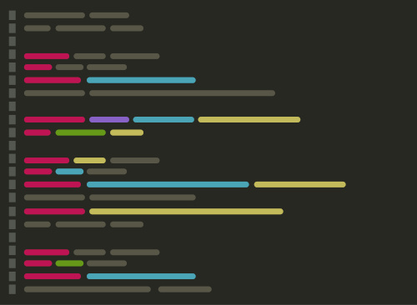
GEOG 4/590: Geospatial Data Science
Lecture 6: Code management
Email: jryan4@uoregon.edu
Office: 163A Condon Hall
Office hours: Mondays 14:00-16:00

Slide 2


Slide 3


Slide 4
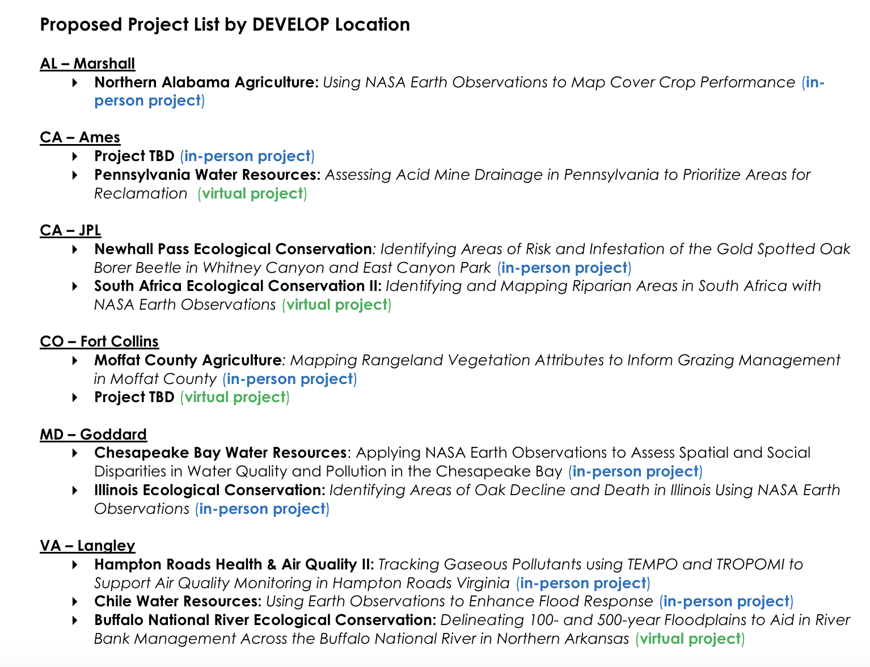

Slide 5
Final project ideas
Izak: Snow + avalanches
Anneke: Accessibility + mobility study
Nicole: Landslides + recovery
Azadeh: Permafrost
Gage:
Catharine: Accessibility + mobility study
Lyssa: Whale migrations

Slide 6
Final project ideas
Evan: SAR
Maddie: Land cover in the Arctic
Eliza: Landslides in Alaska
Dylan: Accessibility + mobility
Ava: NDVI agriculture
Jamel:
James: Spatial hazards + insurance

Slide 7
Final project ideas
Kelsey: Accessibility and mobility
Franki: Landslides + recovery
Jett:
Makayla: Location machine learning
Nicolas: Accessibility + mobility
Dana: Location machine learning
Mason: Vegetation in the Cascades
Jason:

Slide 8
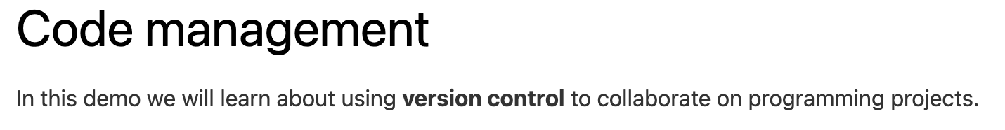
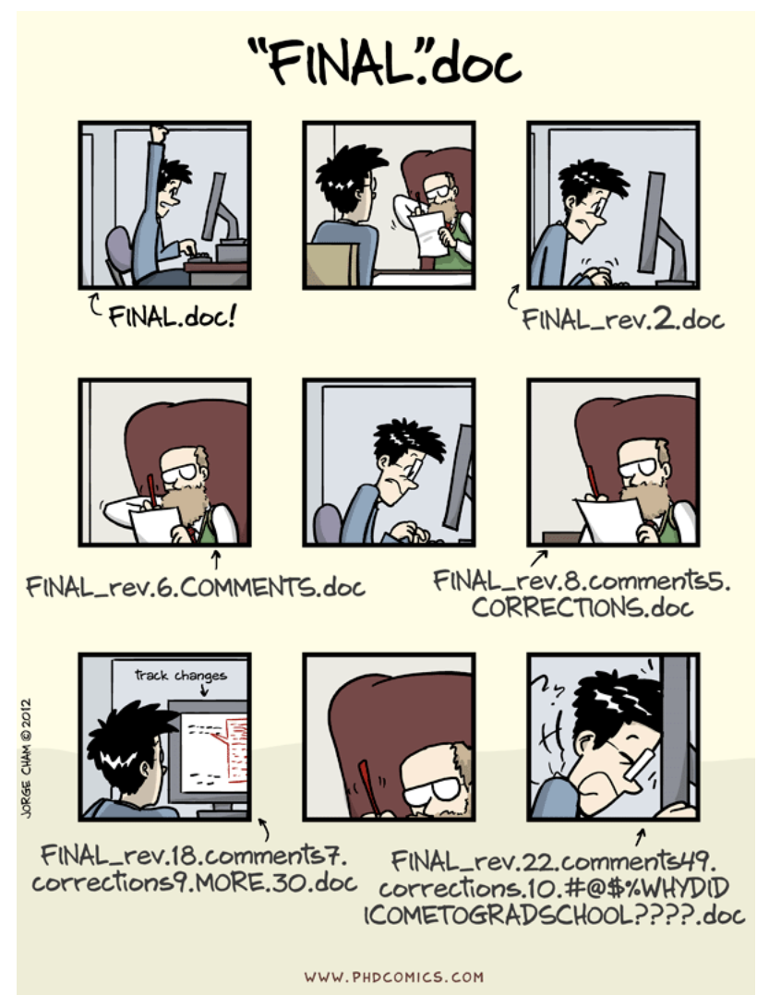
Notes:
We’ve all been in this situation before: it seems unnecessary to have multiple nearly-identical versions of the same document. The danger of losing good versions often leads to the problematic workflow illustrated in the PhD Comics cartoon at the top of this page.
Collaborative writing with traditional word processors is cumbersome. Either every collaborator has to work on a document sequentially (slowing down the process of writing), or you have to send out a version to all collaborators and manually merge their comments into your document. The track changes option can highlight changes for you and simplifies merging, but as soon as you accept changes you will lose their history. You will then no longer know who suggested that change, why it was suggested, or when it was merged into the rest of the document.

Slide 9
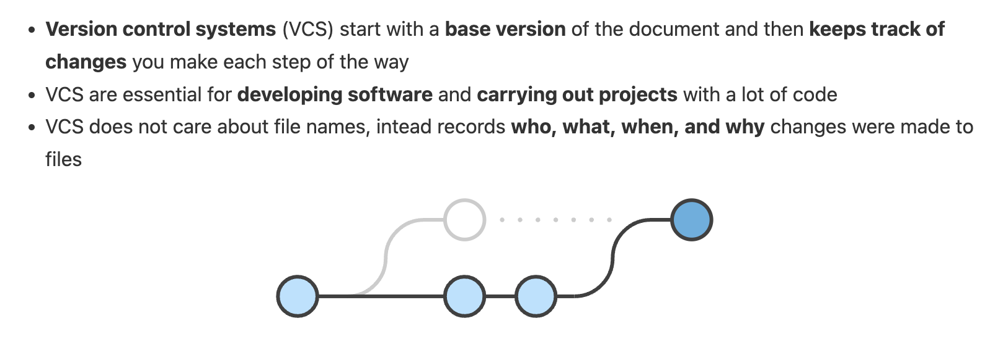

Slide 10
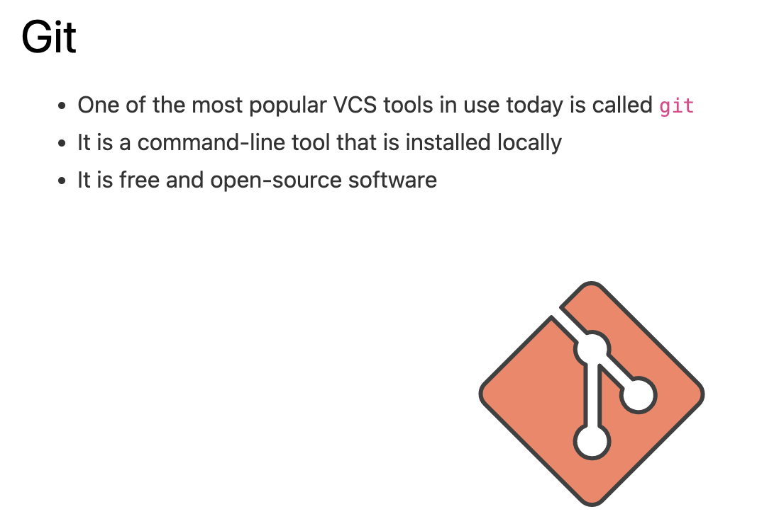

Slide 11
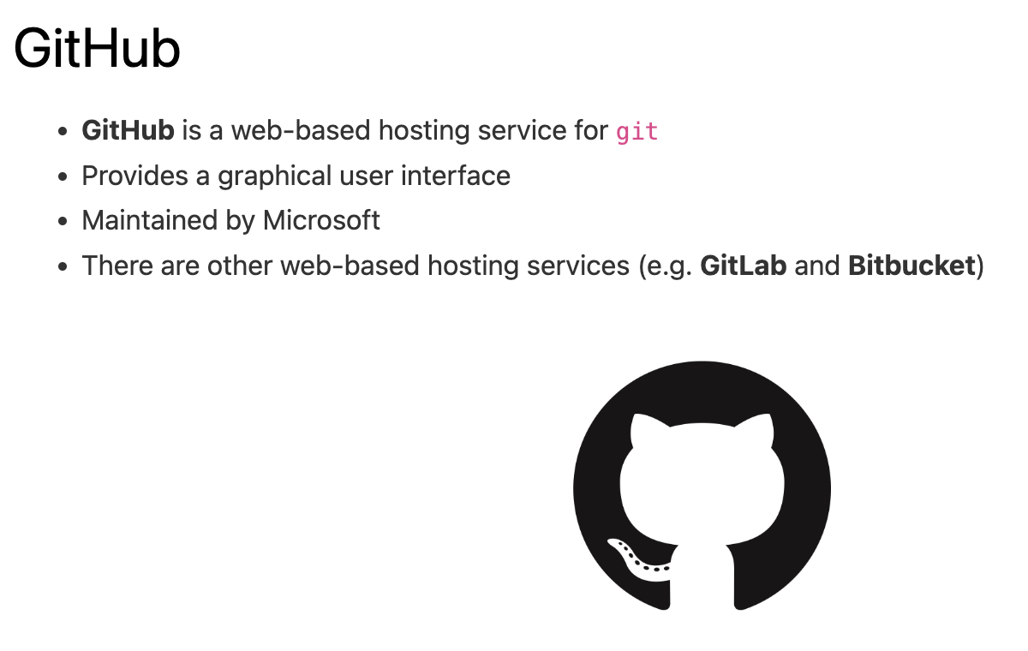

Slide 12
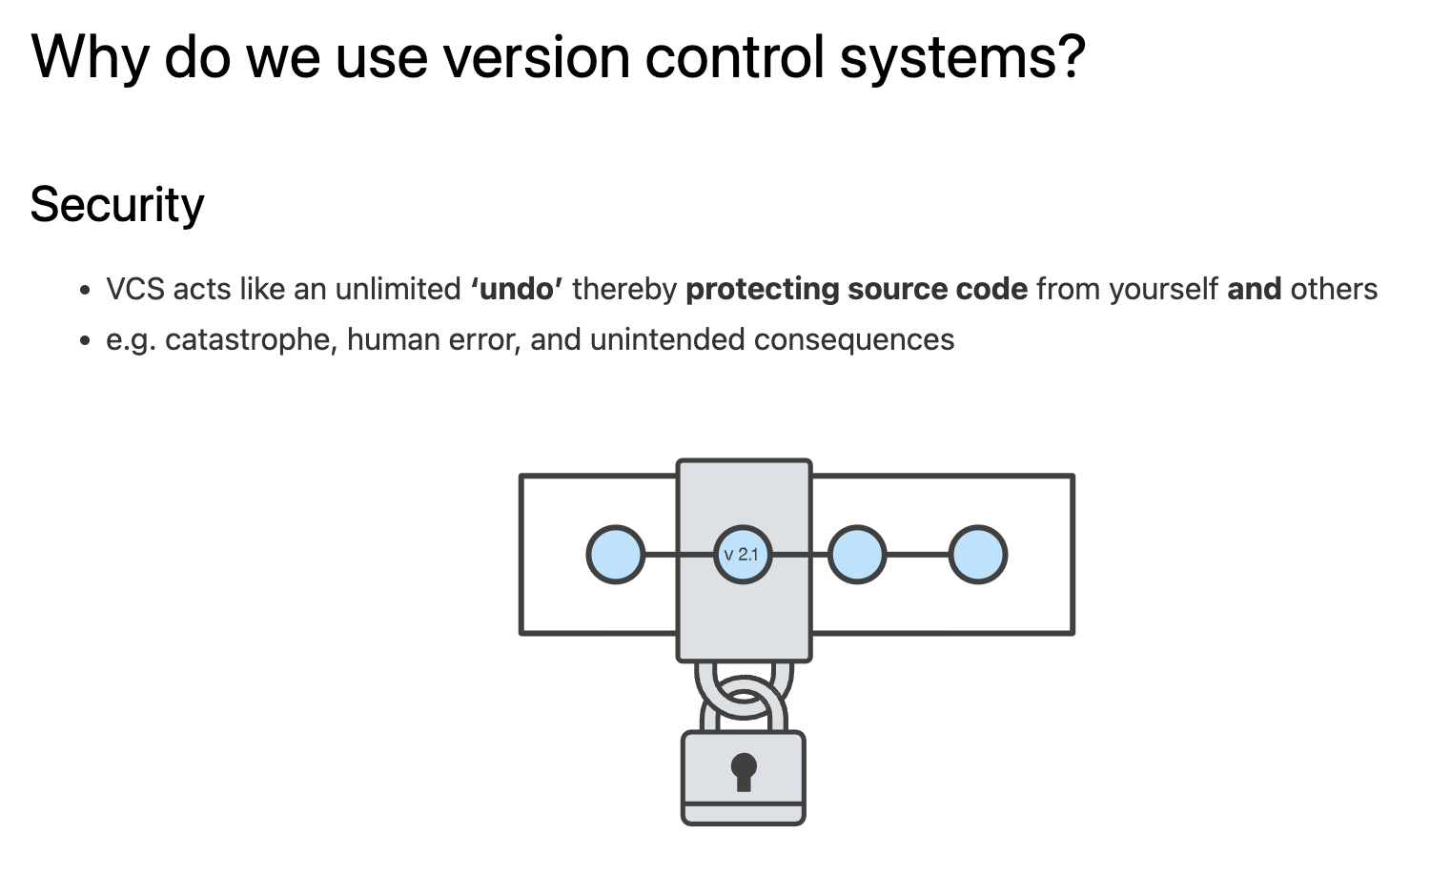

Slide 13
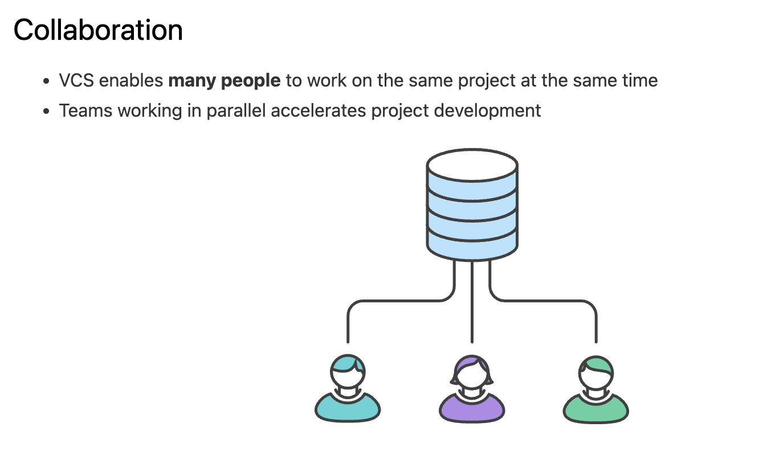

Slide 14
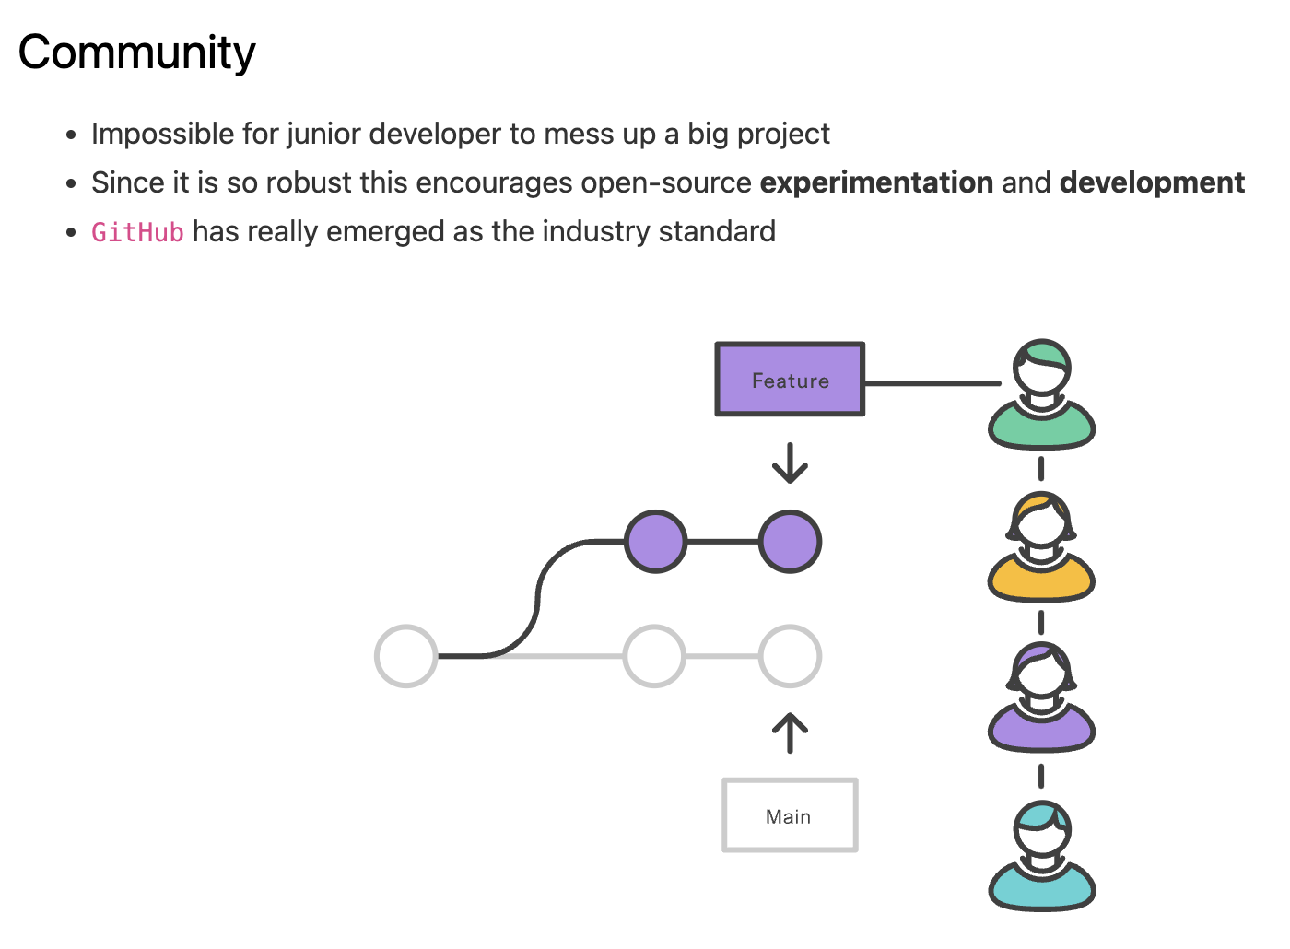

Slide 15
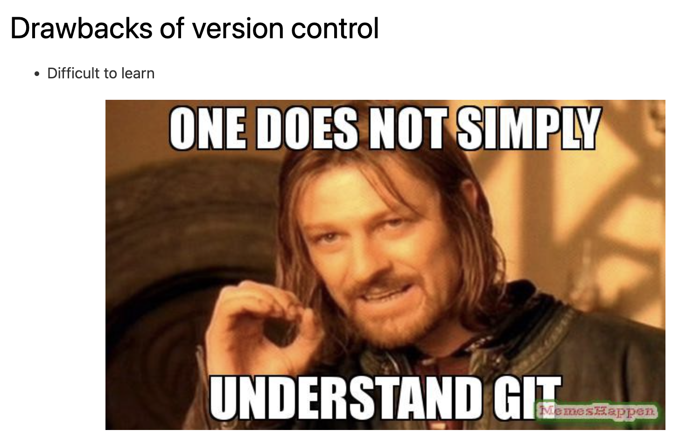

Slide 16
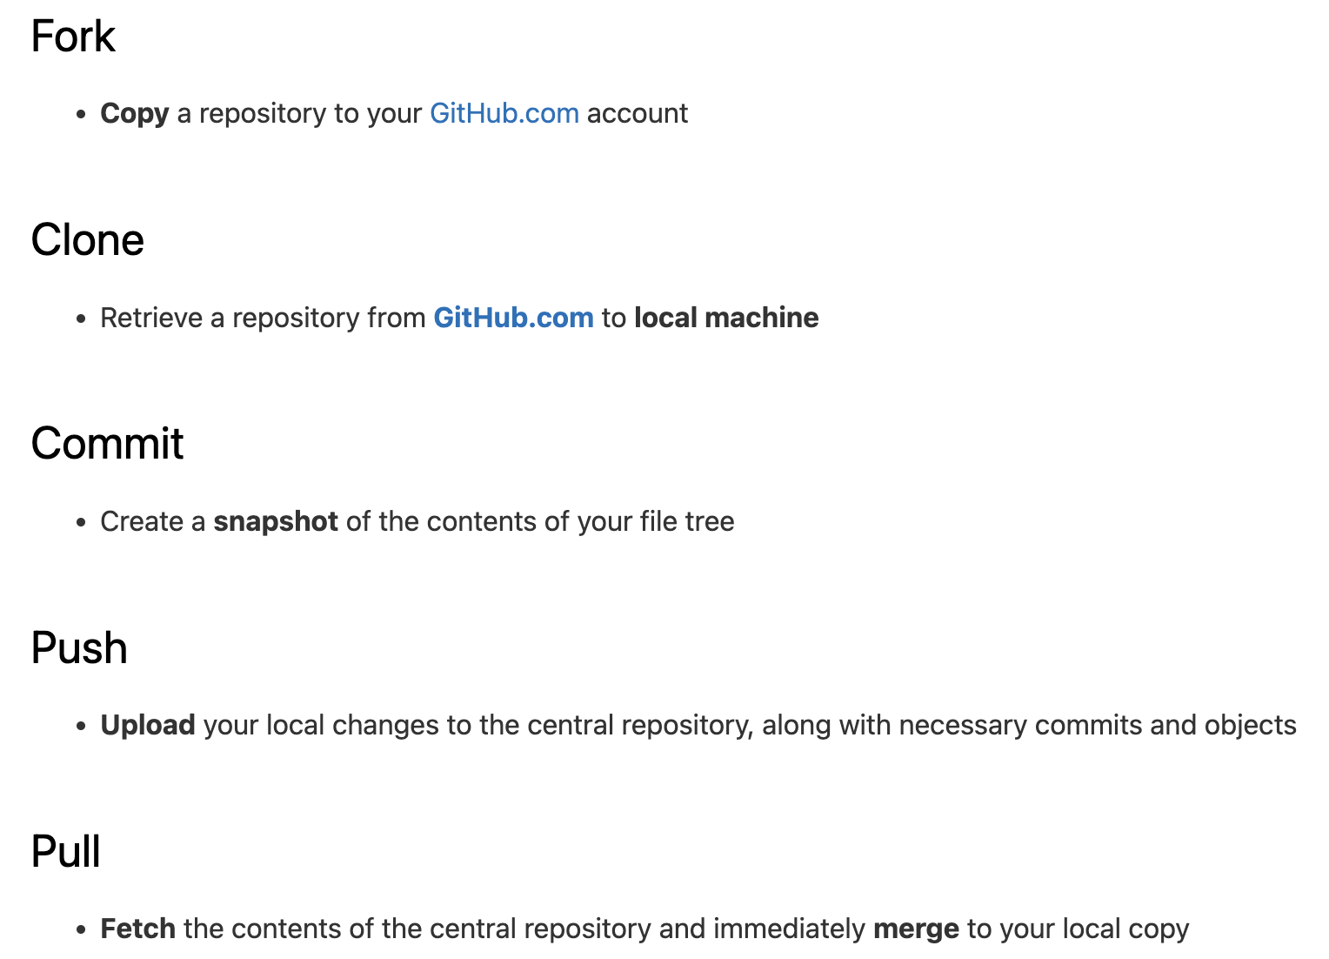

Slide 18
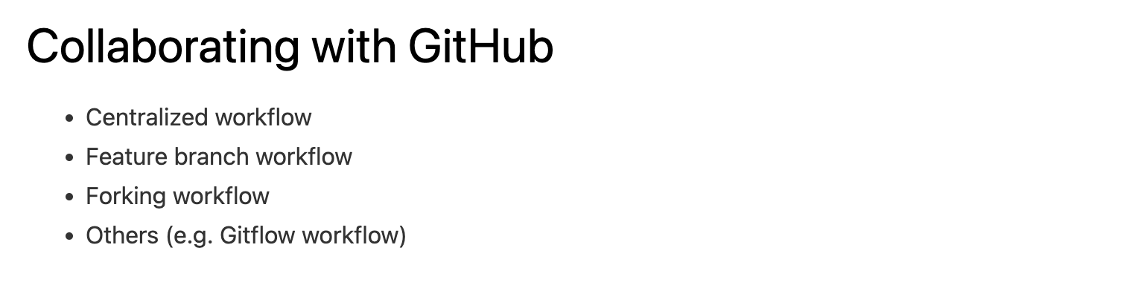

Slide 19
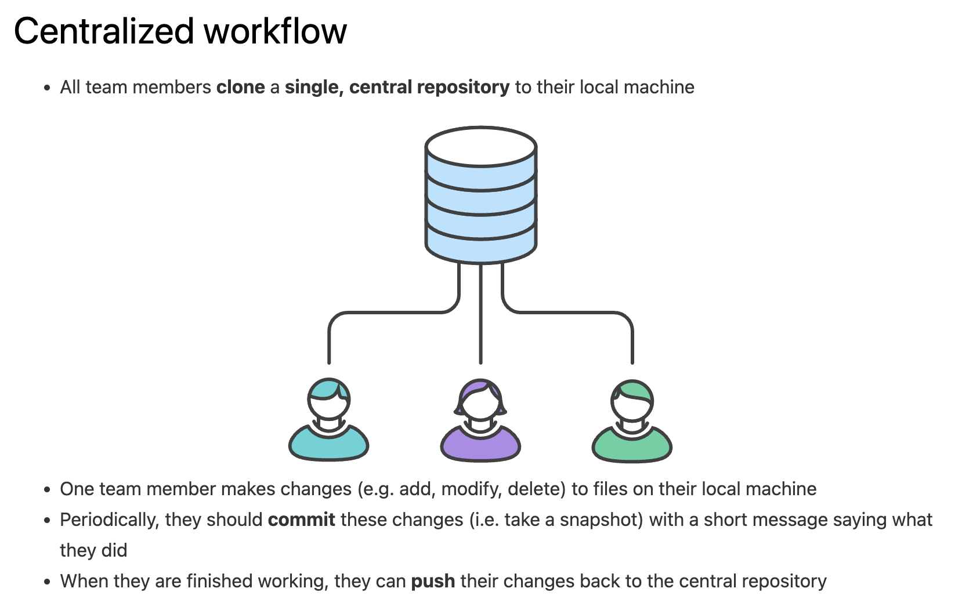

Slide 20
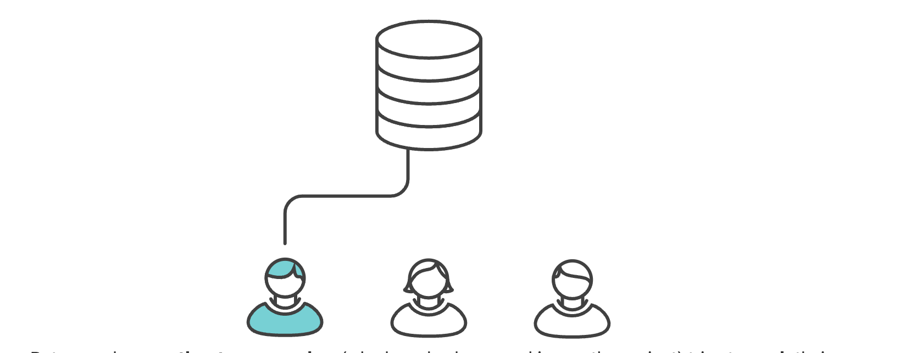

Slide 21
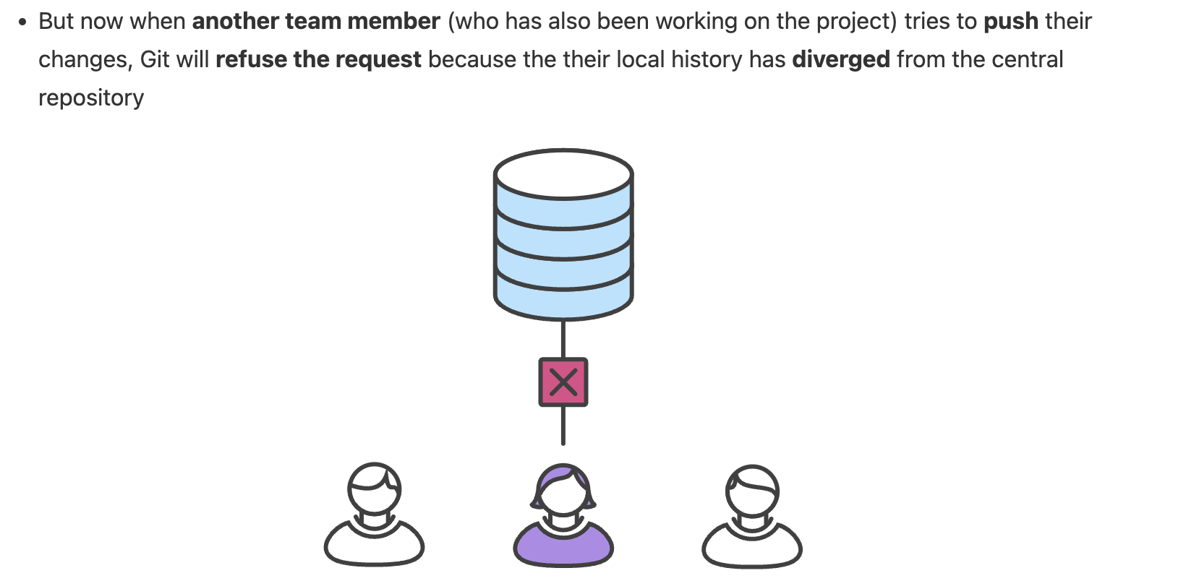

Slide 22
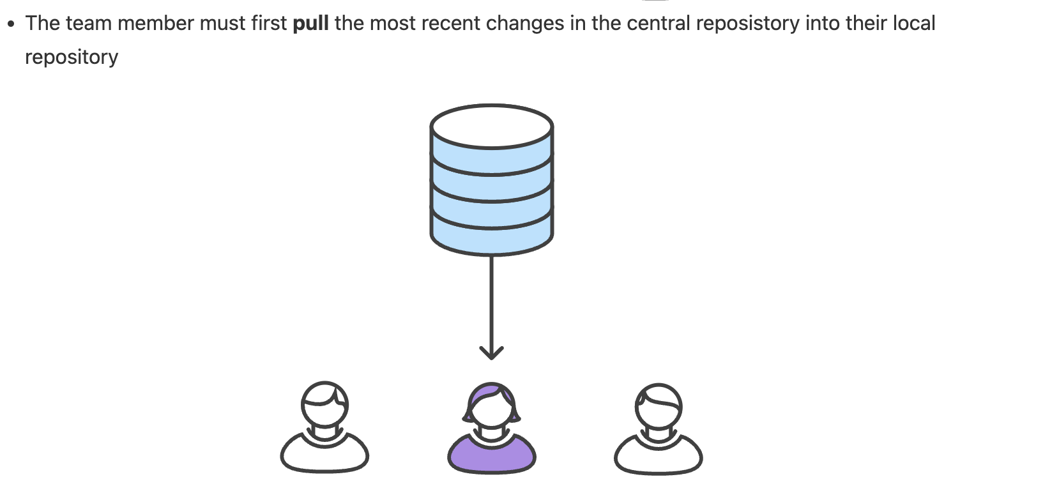

Slide 23
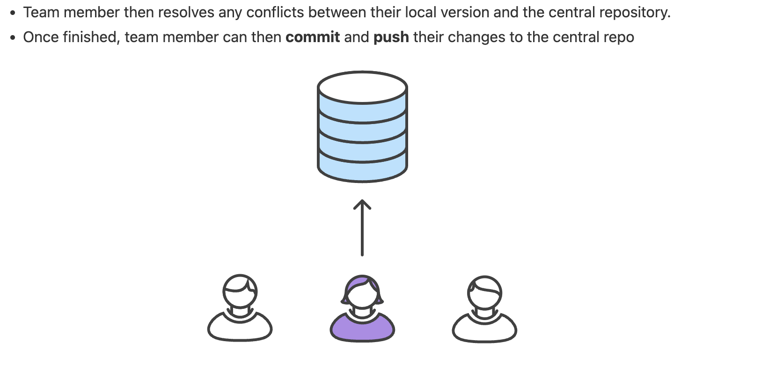

Slide 24
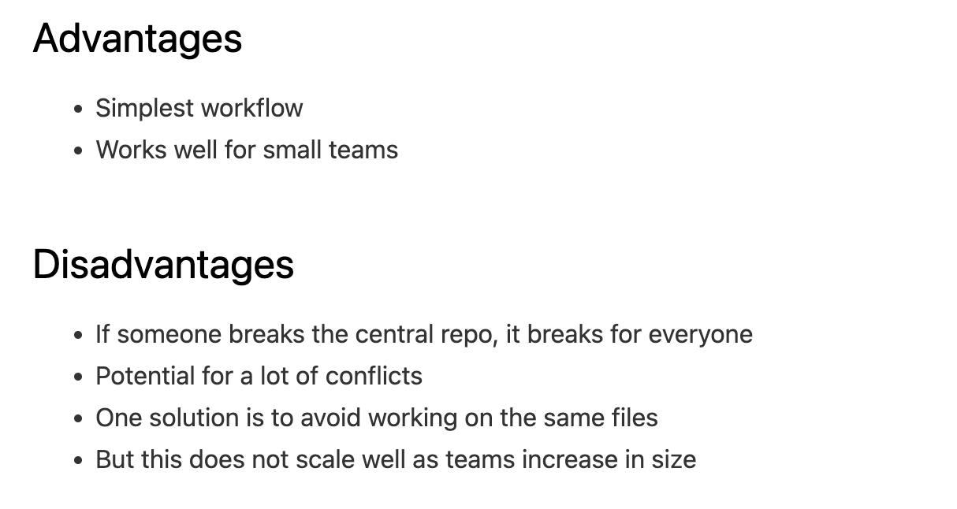

Slide 25
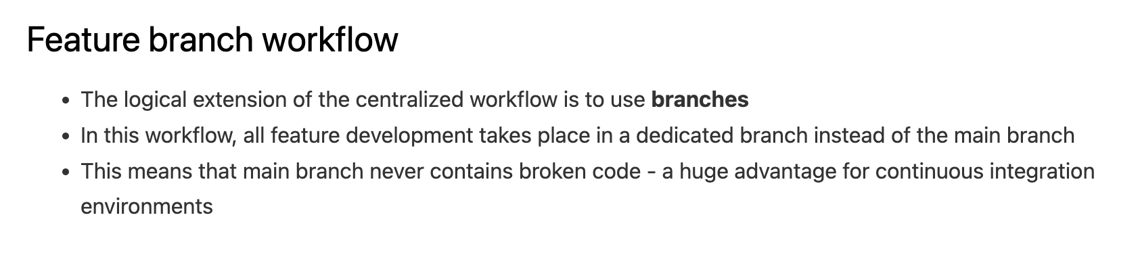

Slide 26
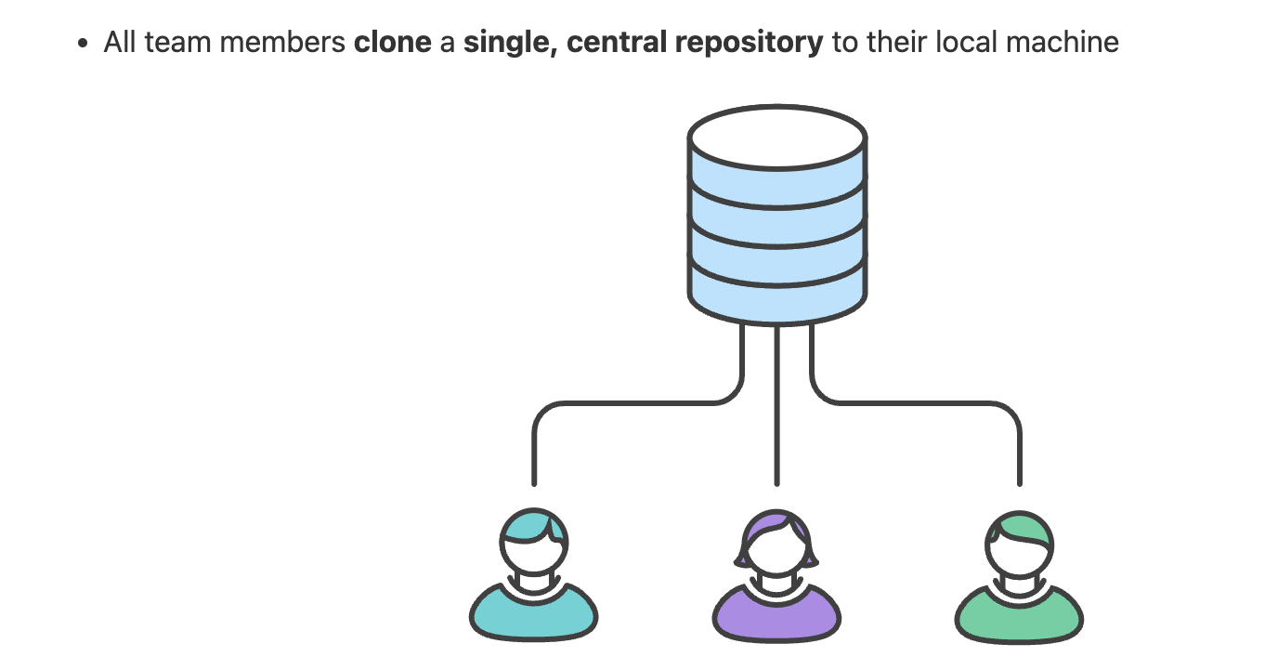

Slide 27
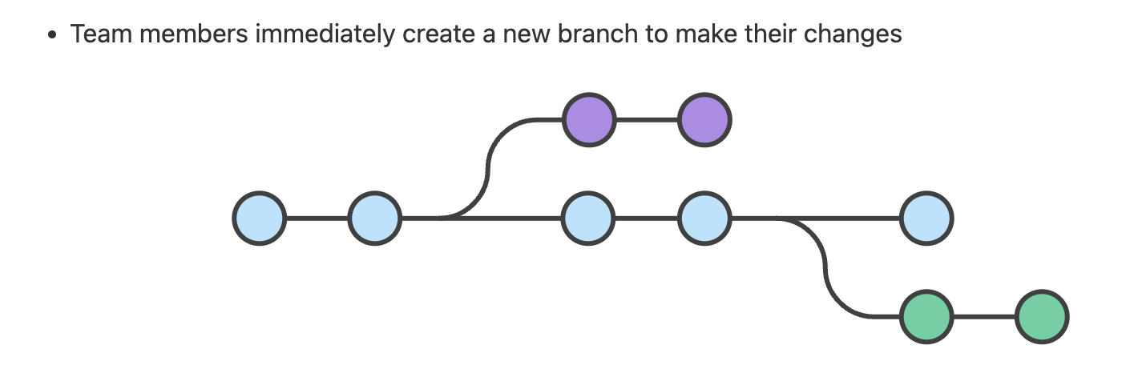

Slide 28
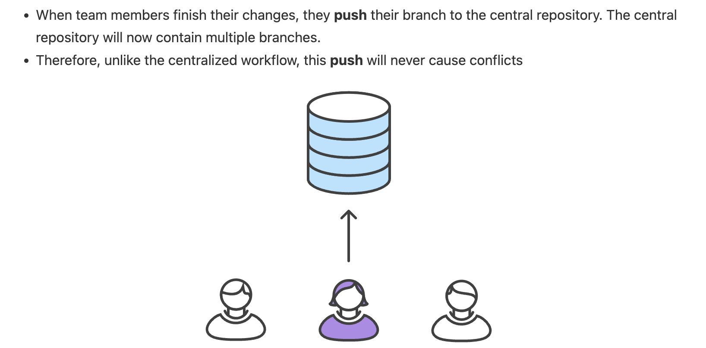

Slide 29
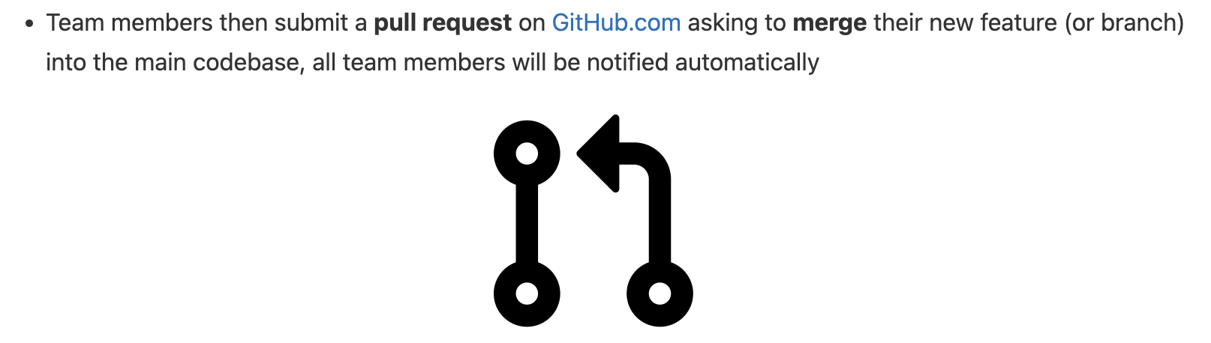

Slide 30
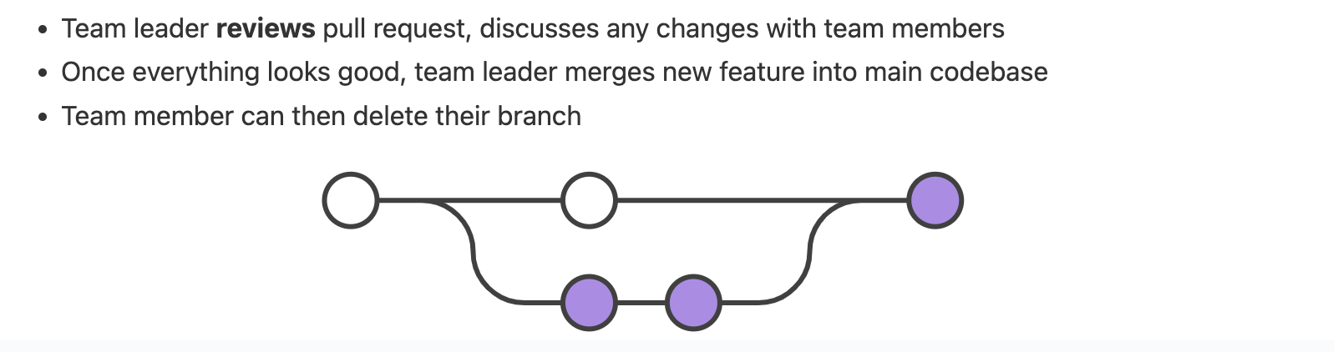

Slide 31
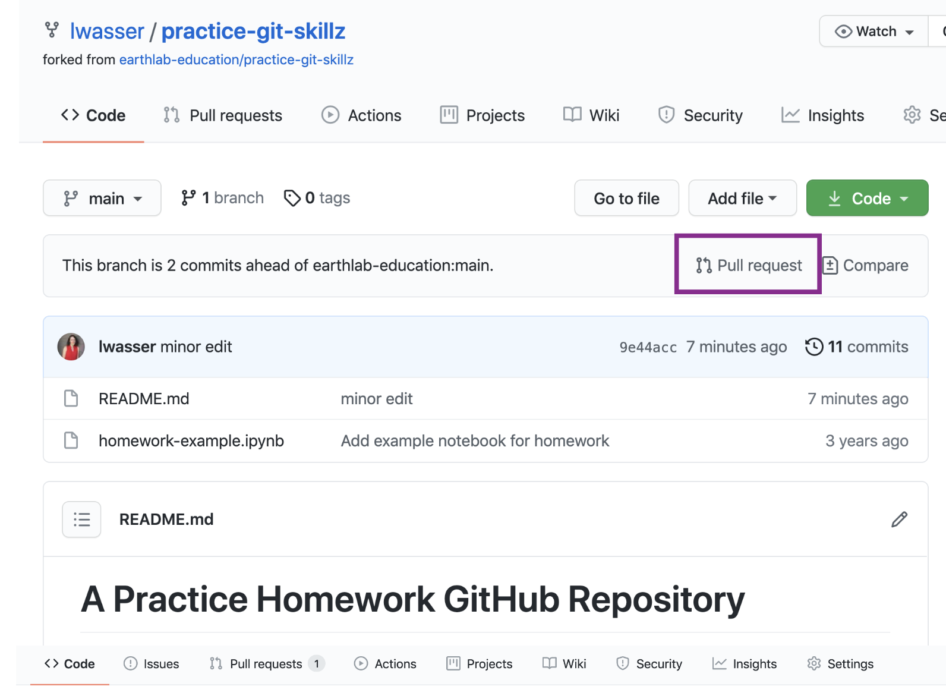

Slide 32
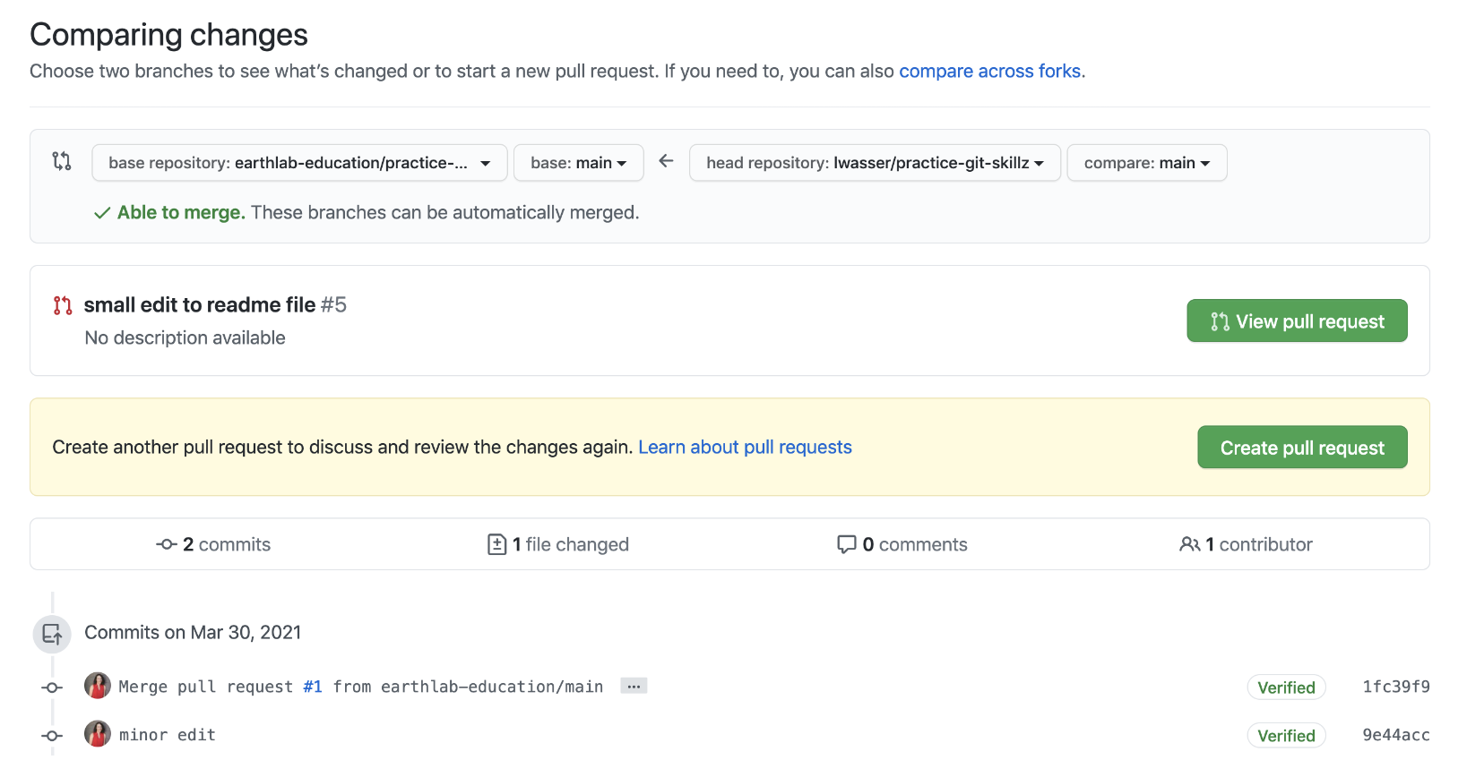

Slide 33
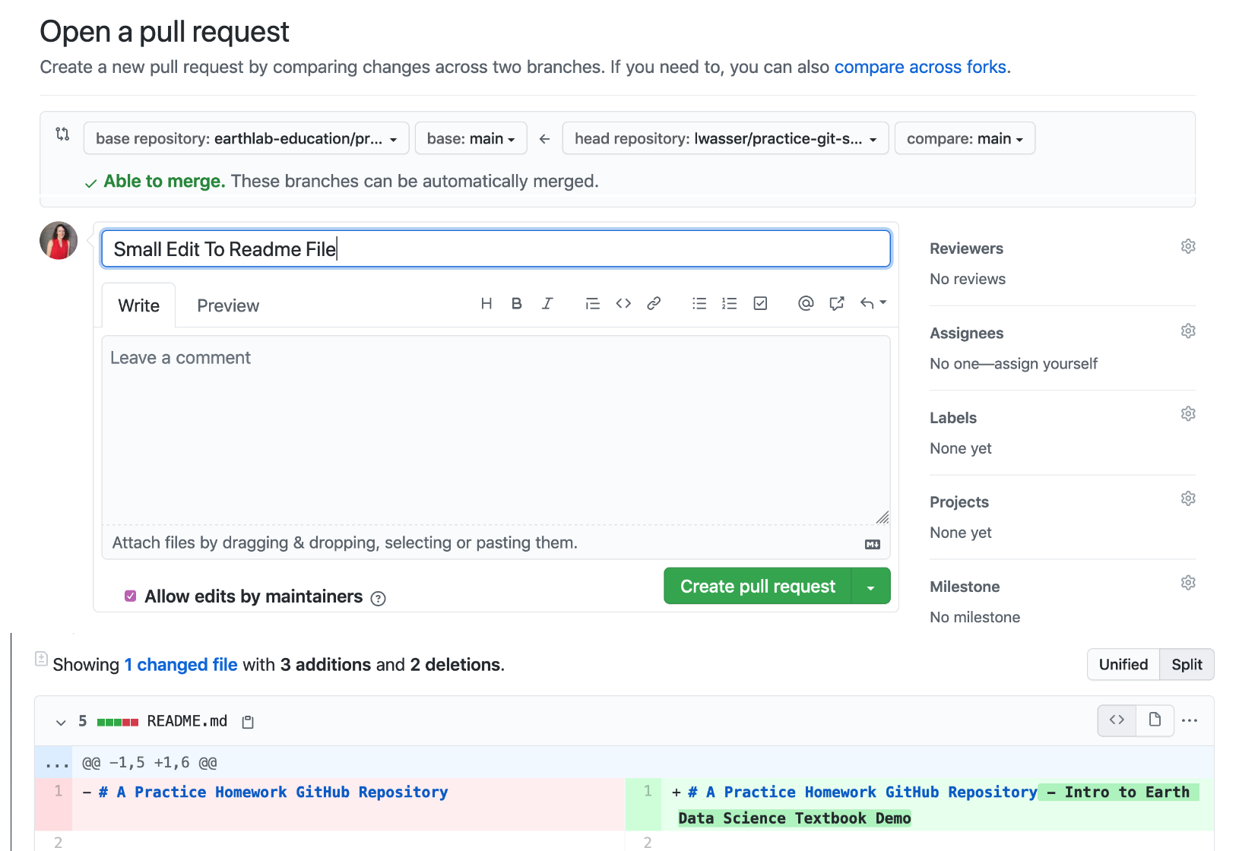

Slide 34
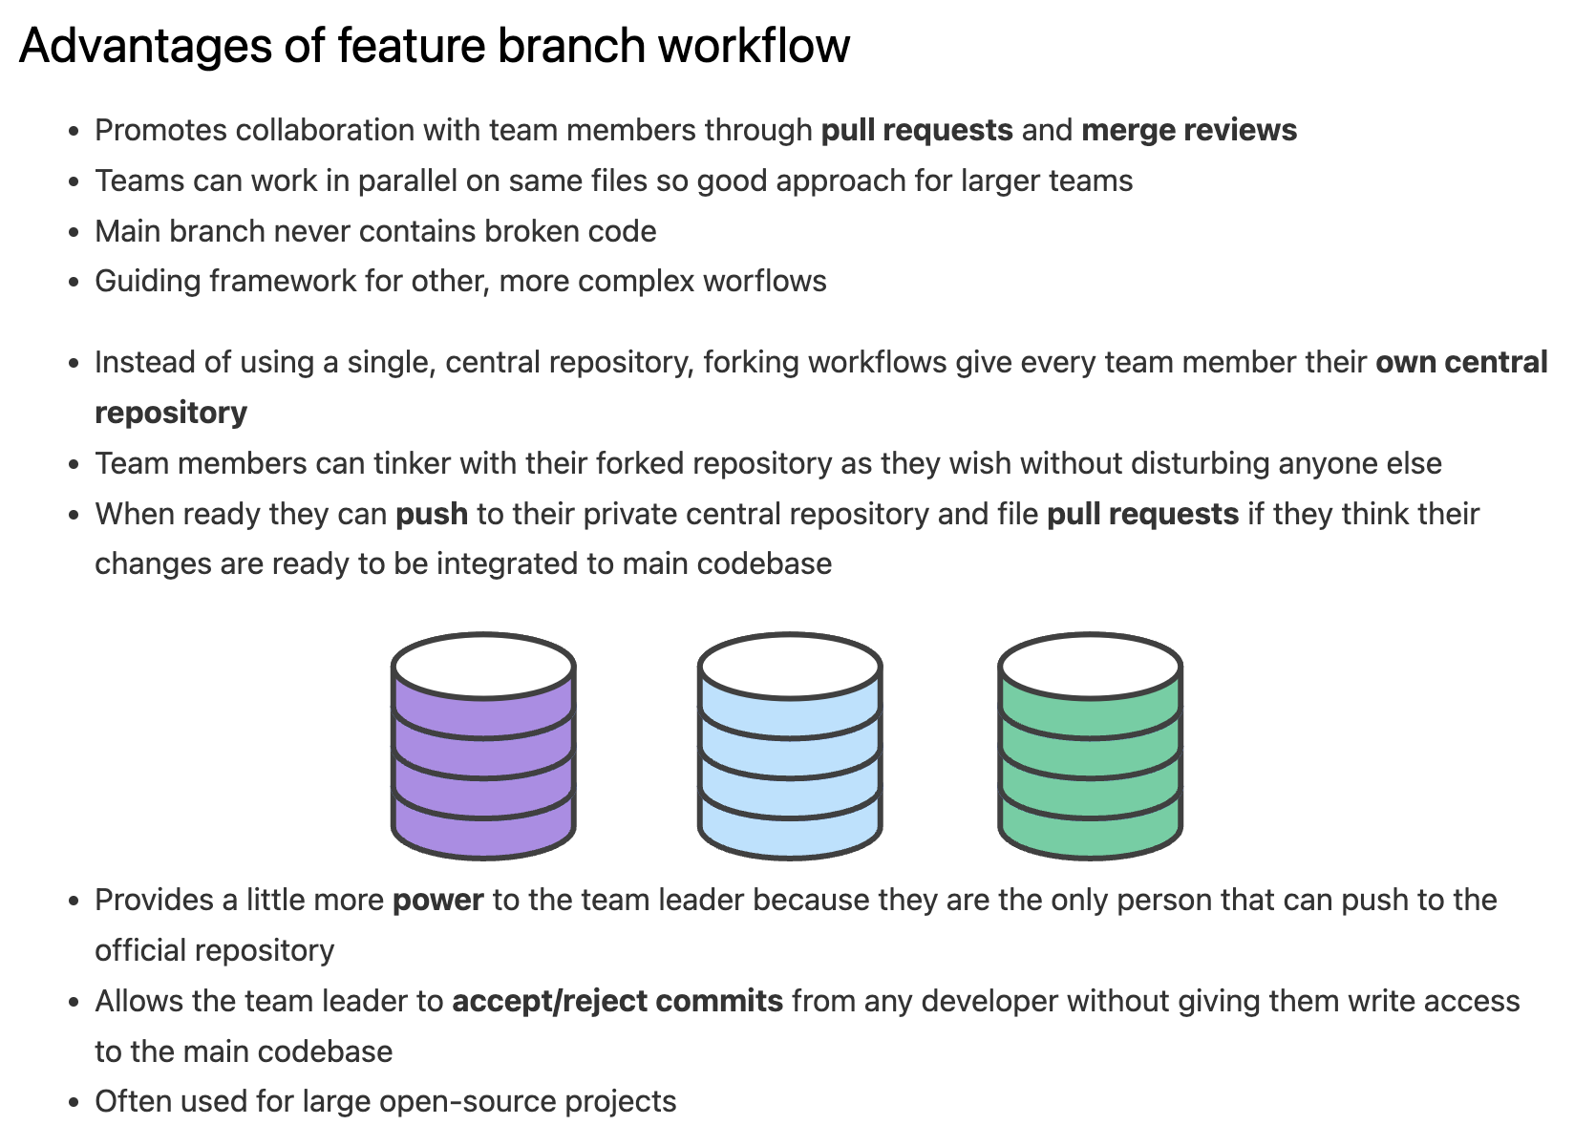

Slide 37
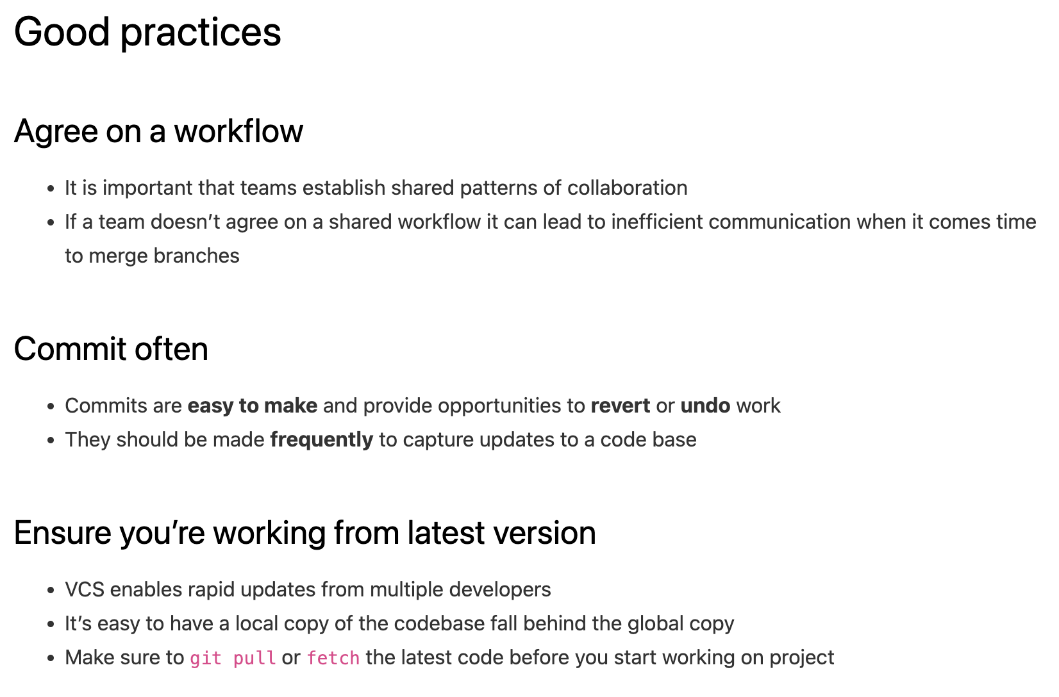

Slide 40
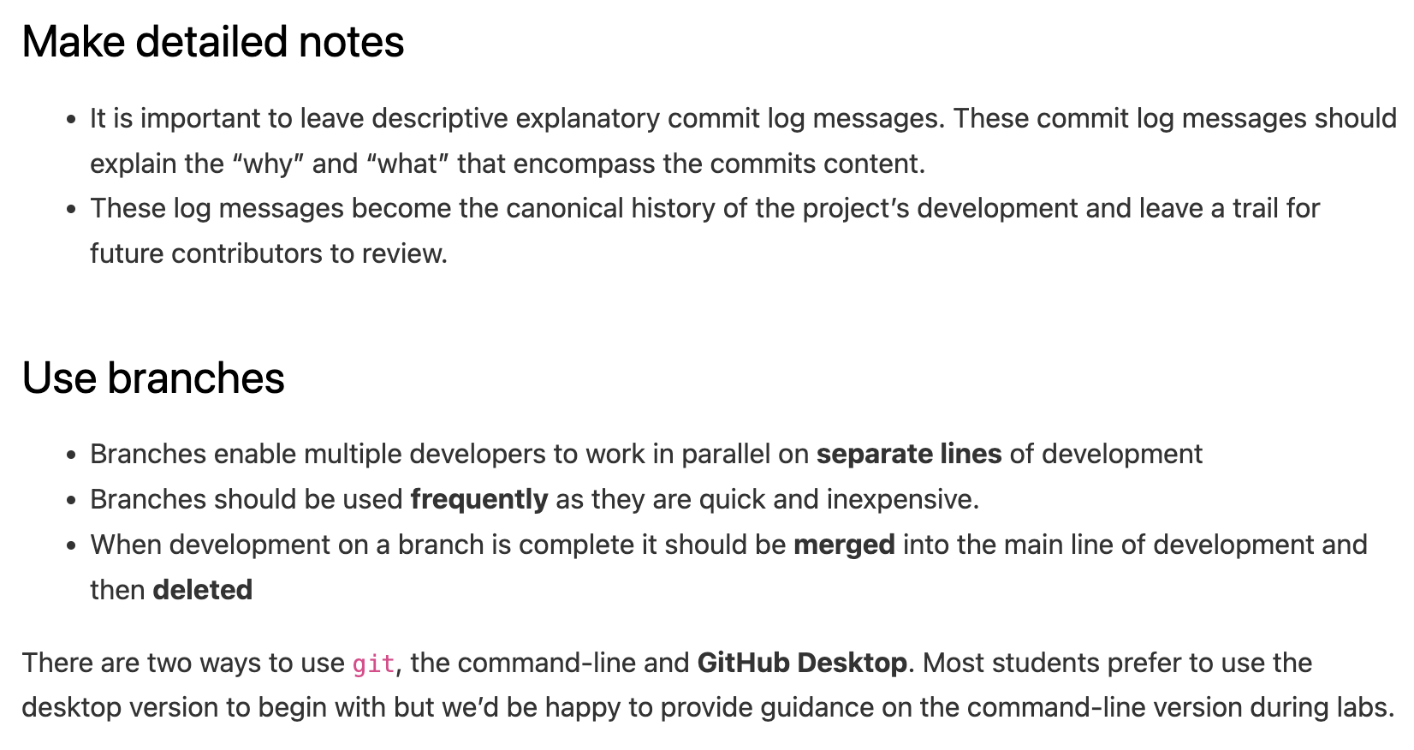

Slide 43
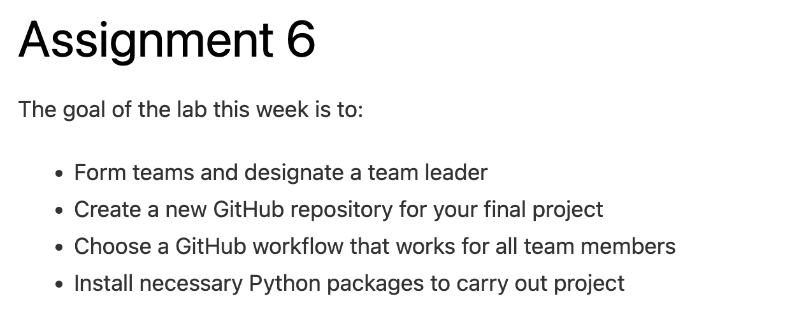
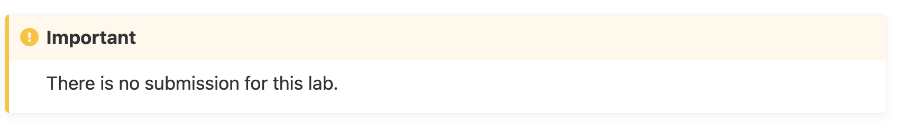
Email: jryan4@uoregon.edu
Office: 163A Condon Hall
Office hours: Mondays 14:00-16:00

